Slide 1

Note: The data and information in this document is reflective of a hypothetical situation and client. This document is to be used for KPMG Virtual Internship purposes only.
Sprocket Central Pty Ltd
Data analytics approach
S S Mallick & Team

Slide 2
Note: The data and information in this document is reflective of a hypothetical situation and client. This document is to be used for KPMG Virtual Internship purposes only.
Agenda
Introduction
Data Exploration
Model Development
Interpretation

Slide 3
Note: The data and information in this document is reflective of a hypothetical situation and client. This document is to be used for KPMG Virtual Internship purposes only.
Introduction
AIM OF THE WORK: Recommendation of high value customers based on customer demographics and attributes.
The 3 data sets Customer demographic, customer address and transactions has attributes of existing customers and their transaction details.
A new list of 1000 potential customers has been provided without transaction details.
Our team task is
to determine customer trends and behavior existing customer dataset
to recommend which customers from the new customer list should be targeted to drive most value to organization

Slide 4
Note: The data and information in this document is reflective of a hypothetical situation and client. This document is to be used for KPMG Virtual Internship purposes only.
Data Exploration
Exploratory Data Analysis is the analysis of data to discover trends, patterns and summary of the main characteristics
The top three industries to which existing customers belong are Manufacturing, Financial Services, and the Health sector. These three sectors comprise approximately 55% of the customer base.
The bottom 3 industries to which existing customers belong are Telecommunication, Agriculture and entertainment industry.

Slide 5
Note: The data and information in this document is reflective of a hypothetical situation and client. This document is to be used for KPMG Virtual Internship purposes only.
Data Exploration
The last 3 year bike purchase data also confirms that high number of bike are sold from Manufacturing, Financial Services and Health industry .
Female customers are slightly higher in number than their counterpart

Slide 6
Note: The data and information in this document is reflective of a hypothetical situation and client. This document is to be used for KPMG Virtual Internship purposes only.
Data Exploration
The plot shows that maximum customer belongs to the age bracket 40-50.
The number of customer gradually increased from age bracket 20-30 up to 40-50.
There is downfall in customer from 50-60.
There is negligible customer beyond the age 70

Slide 7
Note: The data and information in this document is reflective of a hypothetical situation and client. This document is to be used for KPMG Virtual Internship purposes only.
Data Exploration
In Age Category 40-50 maximum number of mass, high net and affluent customers are there
In the age category 30-40 and 40-50 almost similar trend of mass, high net and affluent customers are present
In the age bracket 20-30 lesser number of customers are present compared to age bracket 30-70.

Slide 8
Note: The data and information in this document is reflective of a hypothetical situation and client. This document is to be used for KPMG Virtual Internship purposes only.
Data Exploration
The plot shows that New South Wales state has highest number of customers
Victoria has second highest numbers of customers
Queensland state has the least customers.

Slide 9
Note: The data and information in this document is reflective of a hypothetical situation and client. This document is to be used for KPMG Virtual Internship purposes only.
Model Development
RFM analysis is employed for model development
RFM is a marketing technique used to quantitatively rank and group customers based on the recency, frequency and monetary total of their recent transactions to identify the best customers and perform targeted marketing campaigns
Recency: time since last purchase
Frequency: count of purchases during the time period
Monetary: total value of purchases during the period
RFM score= 100* R_score+10*F_score+M_score

Slide 10
Note: The data and information in this document is reflective of a hypothetical situation and client. This document is to be used for KPMG Virtual Internship purposes only.
Model Development
A new feature recency has been created for storing the time elapsed since the last purchase
Minimum of Recency, Count of product ID and sum of profit values have been calculated for each customer ID
R score, F score and M score from 1 to 4 have been calculated by considering various quartiles.
RFM score calculated and assigned as per the quartiles
Finally Customer segmentation has been done based on RFM score

Slide 11
Note: The data and information in this document is reflective of a hypothetical situation and client. This document is to be used for KPMG Virtual Internship purposes only.
Model Development
Champion customers have RFM score 444 that means most recent, frequent and high value purchase
Similarly Loyal, Becoming loyal, Recent customer, Potential customer, Late bloomer, Loosing customer, High risk Customer, Almost lost customer, Evasive customer and lost customer have been found based on the RFM score in the order
Top 4 rank customers consisting of top 1000 customers are champion, loyal, becoming loyal and recent customers

Slide 12
Note: The data and information in this document is reflective of a hypothetical situation and client. This document is to be used for KPMG Virtual Internship purposes only.
Model Development
The highest number of valued customers are in the age 40-50 bracket
Age bracket 30-40 and 50-60 also have significant high valued customers

Slide 13
Note: The data and information in this document is reflective of a hypothetical situation and client. This document is to be used for KPMG Virtual Internship purposes only.
Model Development
Our Model shows majority of high value customers are from Financial Services, Manufacturing and health industry.

Slide 14
Note: The data and information in this document is reflective of a hypothetical situation and client. This document is to be used for KPMG Virtual Internship purposes only.
Model Development
Majority of high value customers are mass customers
From the model it is found that Female customer are slightly higher but not significantly more in comparison to male. So gender is not playing a major role

Slide 15
Note: The data and information in this document is reflective of a hypothetical situation and client. This document is to be used for KPMG Virtual Internship purposes only.
Model Development
The highest number of valued customers are from the state of New south Wales
Victoria and Queensland are placed at 2nd and 3rd spot
From the RFM segmentation it is found that Female customer are slightly higher but not significantly more in comparison to male. So gender is not playing a major role

Slide 16
Note: The data and information in this document is reflective of a hypothetical situation and client. This document is to be used for KPMG Virtual Internship purposes only.
Interpretation
Our model recommended following criteria to target high valued customers
Majority Customers from New south Wales and Victoria state.
Customers from Financial Services, Manufacturing and Health Industry.
Customers in the age bracket 40-50.
Customers having mass customers wealth segmentation type.

Slide 17
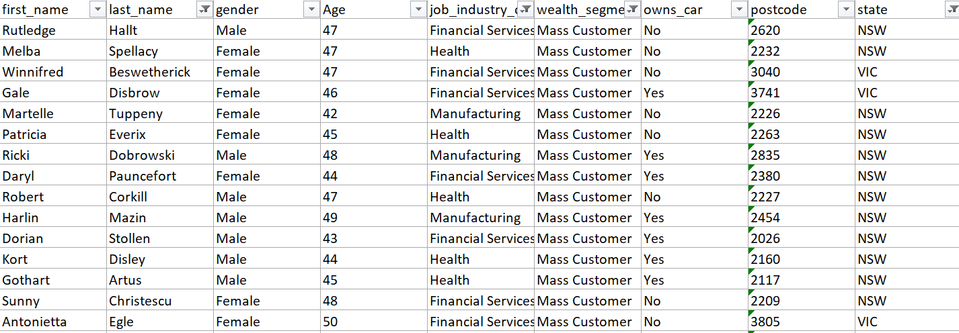
Note: The data and information in this document is reflective of a hypothetical situation and client. This document is to be used for KPMG Virtual Internship purposes only.
Interpretation
Sample Target Customers Profile

Slide 18
Note: The data and information in this document is reflective of a hypothetical situation and client. This document is to be used for KPMG Virtual Internship purposes only.
Thank You

